Slide 1
UE19CS390B – Capstone Project Phase – 2
Project Progress Review #2
Project Title :Twitter Sentiment analysis for Bitcoin Price
Prediction
Project ID : 55
Project Guide : Prof Prajwala
Project Team : Achyut Jagini
Vedanth Mohan
Kaushal Mahajan
Namita Aluvathingal

Slide 2
Outline
Abstract and Scope of the Project
Capstone Project Phase – 1
Summary of work
Inferences drawn from Literature Survey
Expected Deliverables
Timeline

Slide 3
Abstract
Sentiment Analysis is a sub-research area of computational Natural Language Processing.
Sentiment analysis is used to determine positive, negative, and neutral opinions of a text.
Twitter tweets are very different compared to other forms of text, with highly irregular grammar, high emoticon use and sarcasm.
Common out-of-box sentiment analysis are challenged to produce good results on tweets.

Slide 4
Summary of Literature Survey
title | author | models used | metrics
Twitter Sentiment Analysis for Bitcoin Price Prediction | Sara Abdali,Ben Hoskins 2021 | Naive Bayes and SVM BERT | training accuracy of 78% and a peak accuracy of 63% on the test set when C = 0.01.
Recurrent Neural Network Based Bitcoin Price Prediction by Twitter Sentiment Analysis | D. R. Pant, P. Neupane, A. Poudel, A. K. Pokhrel and B. K. Lama - 2018 | Text classification: Word2Vector and Bag-of-Words Sentiment analysis: Naïve Bayes , Bernouli Naïve Bayes, Multinomial Naïve Bayes, Linear Support Vector Classifier and Random Forest | Word2Vector accuracy is 69.82% whereas Bag-of-words accuracy is 78.49%. The accuracy for sentiment classification of tweets is 81.39 % and the price prediction accuracy using RNN is 77.62%.

Slide 5
Summary of Literature Survey
title | author | models used | metrics
Forecasting Bitcoin Price Fluctuation by Twitter Sentiment Analysis | Otabek Sattarov,Heung Seok Jeon,Ryumduck Oh,Jun Dong Lee-2020 | VADER, Random Forest Regression | 62.48%avg acc. 37.52 avg acc error with the extremes being 43.83% and 21.84% .
Cryptocurrency Price Prediction using Sentiment Analysis | Abdul Rehman Khurshid -2021 | VADER Linear support vector classification, multinomial Naive Bayes, and Bernoulli Naive Bayes(classify news and social media sentiment) neural networks (NN), support vector machines (SVM) and random forest (RF) for selected few cryptos aggregated Twitter sentiment change over time periods ranging between 5 minutes and 4 hours LSTM ,historical cryptocurrency prices and data from Sina-Weibo | Logistic regression produced the best results. LSTM 87 percent accuracy rate aggregated method gave 83 %

Slide 6
Summary of Literature Survey
title | author | models used | metrics
Cryptocurrency Price Prediction Using Tweet Volumes and Sentiment Analysis | Jethin Abraham, Daniel Higdon, Jack Nelson, Juan Ibarra -2018 | VADER ”Pearson R” and the p-value(between google trend price and tweet volume) | The Pearson R of the correlation is 0.817 at p-value of 0. The correlation held during periods of increasing and decreasing prices suggest that the relationship is robust to periods of high variance and non-linearity.

Slide 7
Summary of Phase-1 work
Literature survey
Architecture development
Find factors impacting price prediction

Slide 8
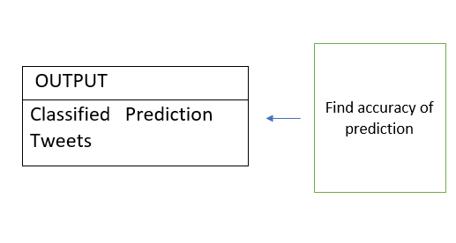
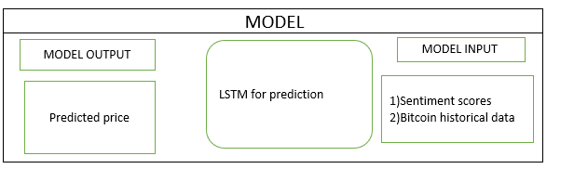
Architecture
PREPROCESSING
1.Convert tweets to lower case 2.Remove URL’s,hashtags, mentions 3.Lemmatization
PREPROCESSING
Creating a slang dataset Converting slangs to full form
INPUT
Tweets
Sentiment analysis
VADER used to find sentiment of tweets

Slide 9
Expected Deliverables
Data preprocessing
Convert tweets to lowercase
Remove hashtags,URL’s ,mentions.
Remove stopwords
Lemmatization
Add sentiment scores and professions to dataset
Compute sentiment scores using VADER
Get professions of users
Add columns to dataset

Slide 10
Expected Deliverables
Combine datasets
Convert dates of bitcoin prices to utc format.
Combine prices with tweets data.

Slide 11
Expected Deliverables
Contribution of members
Name | Tasks assigned | Development
Kaushal | Clean dataset Get professions of users | 60 lines code Time -32 hours
Vedanth | Tweets Preprocessing | 45 lines code Time-25 hours
Achyut | Few lines -preprocessing Combine tweets ,bitcoin price | 48 lines code Time- 30 hours
Namita | Compute tweet scores | 45 lines code Time-22 hours

Slide 12
Expected Deliverables
Python Modules used
pandas
beautiful soup
requests
tqdm
drive
vaderSentiment
nltk
re

Slide 13
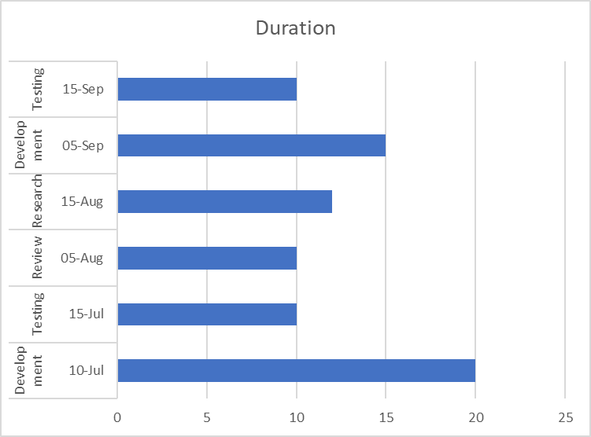
Timeline

Slide 14
References
E. Şaşmaz and F. B. Tek, "Tweet Sentiment Analysis for Cryptocurrencies," 2021 6th International Conference on Computer Science and Engineering (UBMK), 2021, pp. 613-618, doi: 10.1109/UBMK52708.2021.955891
Twitter Sentiment Analysis for Bitcoin Price Prediction - Sara Abdali Ben Hoskins 2021
D. R. Pant, P. Neupane, A. Poudel, A. K. Pokhrel and B. K. Lama, "Recurrent Neural Network Based Bitcoin Price Prediction by Twitter Sentiment Analysis," 2018 IEEE 3rd International Conference on Computing, Communication and Security (ICCCS), 2018, pp. 128-132, doi: 10.1109/CCCS.2018.8586824.

Slide 15
References
O. Sattarov, H. S. Jeon, R. Oh and J. D. Lee, "Forecasting Bitcoin Price Fluctuation by Twitter Sentiment Analysis," 2020 International Conference on Information Science and Communications Technologies (ICISCT), 2020, pp. 1-4, doi: 10.1109/ICISCT50599.2020.9351527.
Abraham, Jethin; Higdon, Daniel; Nelson, John; and Ibarra, Juan (2018) "Cryptocurrency Price Prediction Using Tweet Volumes and
Sentiment Analysis," SMU Data Science Review: Vol. 1 : No. 3 , Article 1

Slide 16
Thank You

